Slide 1
PROJECT TITLE : PREDICTING EARTH’S FUTURE:CLIMATE & POPULATION FORECASTING USING MACHINE LEARNING
PROJECT OBJECTIVES:
Forecast global temperature and population trends using ML
Use historical data and train regression models.
Visualize future projections for years like 2030, 2040 and 2050.
Present clear and meaningful insights from the predictions

Slide 2
INTRODUCTION
The Climate change and rapid population growth are two major global challenges affecting environmental sustainability and human life.
Machine Learning provides intelligent techniques to analyze historical environmental and demographic data to predict future climate conditions and population trends.
This project focuses on:
Predicting future climate changes
Forecasting population growth
Understanding environmental impacts
Supporting sustainable development planning

Slide 3
ABSTRACT
This project aims to develop a machine learning-based prediction system for forecasting climate and population changes using historical datasets. The system analyzes environmental factors such as temperature, CO₂ emissions, rainfall, and population statistics to identify future trends.
Various machine learning algorithms including Linear Regression, Decision Tree Regression, and Random Forest Regression are used for prediction and analysis.
The proposed system helps in:
Understanding future climate conditions
Estimating population growth
Analyzing environmental impact
Supporting government and research decisions
The project demonstrates how AI and Machine Learning can contribute to environmental sustainability and future planning.

Slide 4
PROBLEM STATEMENT:
Traditional forecasting methods are insufficient for accurately predicting future climate and population changes due to:
Large volumes of environmental data
Complex climate patterns
Rapid population growth
Increasing carbon emissions
Unpredictable environmental variations
There is a need for an intelligent prediction system capable of:
Analyzing historical data efficiently
Predicting future climate conditions
Forecasting population growth accurately
Supporting environmental sustainability decisions

Slide 5
OBJECTIVES:
Main Objectives:
Additional Objectives:
To analyze climate and population datasets
To build a machine learning prediction model
To forecast future climate conditions
To estimate future population growth
To visualize environmental trends
Improve prediction accuracy
Compare ML algorithms
Generate analytical graphs and reports

Slide 6
Problem Statement:
Traditional forecasting methods are insufficient for accurately predicting future climate and population changes due to:
Large volumes of environmental data
Complex climate patterns
Rapid population growth
Increasing carbon emissions
Unpredictable environmental variations
There is a need for an intelligent prediction system capable of:
Analyzing historical data efficiently
Predicting future climate conditions
Forecasting population growth accurately
Supporting environmental sustainability decisions

Slide 7
SIZE OF THE DATASET :
SIZE OF THE DATASET :
Climate dataset → 3 – 4 kb
Population dataset → 4 – 5 kb
FEATURES OF THE DATASET :
Climate dataset:
Year , CO2 emission, sea level, Temperature → (predicting global temperature)
Population dataset:
Year, Birth rate, Death rate, Urban population, Life expectancy, population(in billions) → (predicting population)

Slide 8
WHY THIS ALGORITHM ?
MODEL USED HERE IS LINEAR REGRESSION (OR MULTIVARIATE REGRESSION ).
Simple, interpretable, and fits well with time-series and numeric prediction tasks
Ideal for small datasets and continuous outputs (like temperature or population)
Helps observe trends over years (e.g., Year vs CO₂ vs Temp)

Slide 9
PREPROCESSING TECHNIQUES:
THERE ARE TOTALLY 5 PREPROCESSING TECHNIQUES USED IN THIS:
Handling missing values:
The technique used in this is Linear Interpolation.
This keeps smooth trend over time
2. Outlier detection and handling:
Replacing abnormal values or extremely high spikes into NaN . Outliers distort regression models and reduce accuracy.

Slide 10
PREPROCESSING TECHNIQUES:
3. Data type conversion:
Converting strings / object columns into float using pd.to_numeric(errors = ‘coerce’) , because machine learning models only work with numerical inputs.
4. Feature scaling (Normalization):
MinMaxscaler from sklearn.preprocessing to scale features like population, CO2, temperature , etc.. This ensures all features are in same scale(0 to 1), which improves model performance and accuracy.
5. Data Expansion:
Generated additional rows by projecting future values based on the latest trend using numpy and extrapolation using average yearly increase. This helps to build predictive model even if the real data is not present.

Slide 11
SCOPE
we forecast the planet's future by focusing on two critical aspects: climate trends and population growth. The uniqueness of this project lies in its combined approach — bringing both under a single framework to study the interdependence between human activity and environmental impact.

Slide 12
LITERATURE SURVEY:
SI.NO | TITLE | YEAR | OBJECTIVE | ALGORITHM
1 | Using Machine Learning in Statistical Models for Population Forecasting in Iraq | 2025 | To forecast the population of Iraq, comparing ML methods vs classical (statistical) models | Neural Networks + ARIMA
2 | An LSTM-PINN Hybrid Method to the specific problem of population forecasting | 2025 | To forecast population evolution under different fertility policy scenarios, combining domain knowledge with sequential dependency | PINN & LSTM PINN hybrid models
3 | Comparison Of 6 Machine Learning Models in Estimating Population Growth | 2024 | To compare multiple ML methods for estimating population growth, examine which works best under which conditions | Linear Regression, Logistic Regression, Decision Trees, Random Forest, Neural Networks, SVM
4 | Machine Learning Approaches for Climate Change Prediction: A Comparative Study | 2024 | To compare multiple ML / ensemble / deep learning methods on climate indicators such as temperature/precipitation, and see which give best accuracy | CNN, RNN, Random Forests, Ensemble Methods (hybrids)
5 | Research on Global Climate Change Prediction based on Machine Learning Model | 2024 | To use ML to predict global climate change while reducing computational cost and complexity of physical models | Machine Learning (type not always specific in abstract, but likely regression / ensemble methods)

Slide 13
ARCHITECTURE DIAGRAM:
DATA SOURCES
VISUALIZATIONS
DEPLOYMENT / DELIVERABLES
DATA INGESTION
MODEL TRAINING
DATA PREPROCESSING & CLEANING
FEATURE ENGINEERING / SELECTION

Slide 14
Algorithms Used:
1. Linear Regression
Used for basic trend prediction.
2. Decision Tree Regression
Used for nonlinear data analysis.
3. Random Forest Regression
Used for higher accuracy and stable predictions.

Slide 15
Tools and Technologies Used:
Programming Language
Python
Libraries
Pandas
NumPy
Scikit-learn
Matplotlib
Seaborn
Platform
Jupyter Notebook / VS Code

Slide 16
Novelty of the Project:
Combines climate prediction and population forecasting in one system
Uses multiple machine learning algorithms for comparison
Provides graphical trend analysis
Supports environmental sustainability planning
Higher prediction accuracy using Random Forest Regression

Slide 17
RESULTS:
The machine learning model was successfully developed to analyze and predict future climate and population trends using historical datasets. Different regression algorithms were trained and evaluated to forecast temperature rise, CO₂ emission growth, sea-level variation, and population increase.
The dataset preprocessing stage included:
Handling missing values
Feature scaling
Data normalization
Splitting training and testing datasets
After training multiple models, the Random Forest Regression model produced the best prediction accuracy compared to Linear Regression and Decision Tree algorithms.

Slide 18
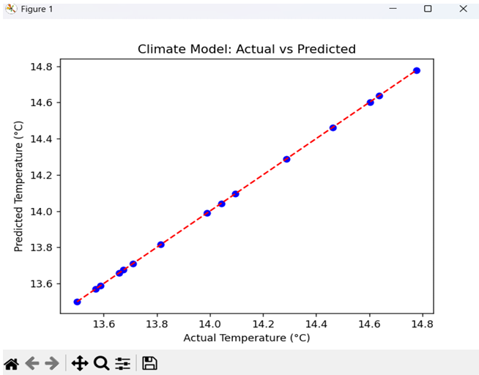
OUTPUT AND ANALYSIS:

Slide 19
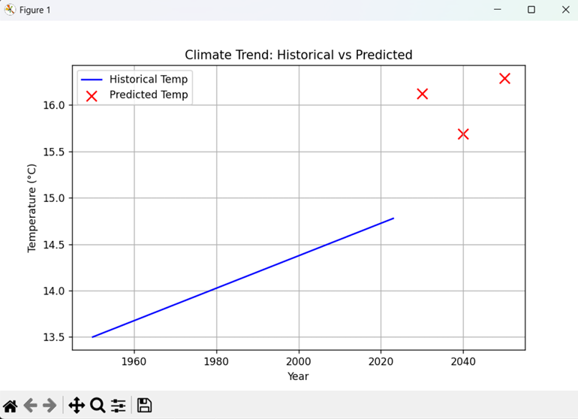

Slide 20
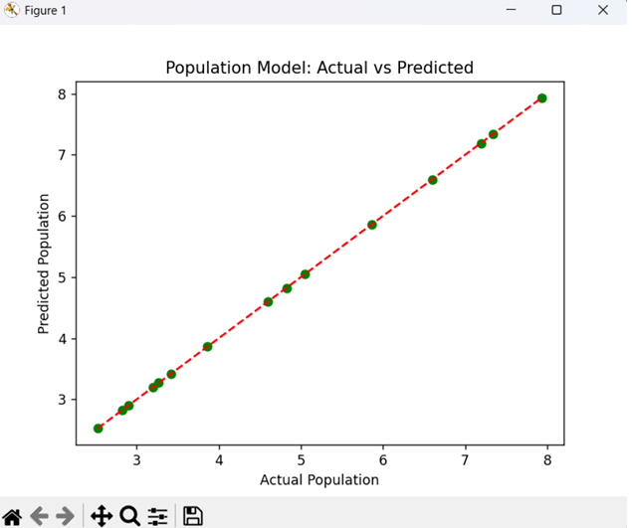

Slide 21
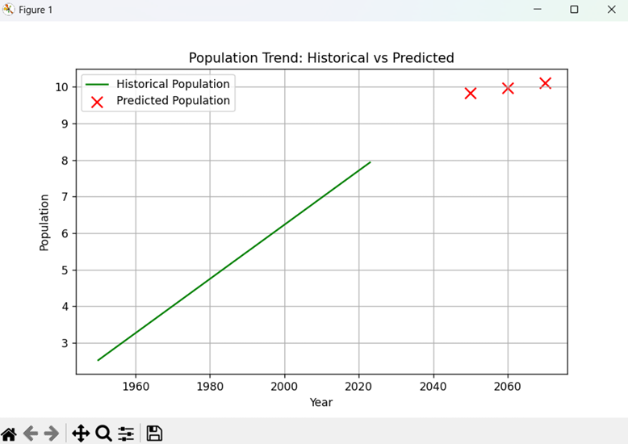

Slide 22
REFERENCES:
[5] “Current Progress in Subseasonal-to-Decadal Prediction Based on Machine Learning,” Applied Computing and Geosciences, 2024. [Online]. Available: https://www.sciencedirect.com/science/article/pii/S259019742400048X
[6] “Analysis, Characterization, Prediction, and Attribution of Extreme Atmospheric Events with Machine Learning and Deep Learning Techniques,” Theoretical and Applied Climatology, Springer, 2024. [Online]. Available: https://link.springer.com/article/10.1007/s00704-023-04571-5
[7] United Nations, “World Population Prospects 2024,” 2024. [Online]. Available: https://www.un.org/development/desa/pd/world-population-prospects-2024
[8] Scikit-learn Developers, “Scikit-learn: Machine Learning in Python,” [Online]. Available: https://scikit-learn.org/stable/
[9] Kaggle, “Climate Change Datasets,” [Online]. Available: https://www.kaggle.com/datasets
[10] Python Software Foundation, “Python Documentation,” [Online]. Available: https://docs.python.org/3/

Slide 23
THANK YOU

